Slide 1
Analyzing the Relationships Between Median Housing Value and its Possible Influences in Boston in the Late 1900’s
Luke Abbatessa and Andy Babb

Slide 2
Problem Statement and Background
Problem: How variables such as crime, whether an area is primarily residential or not, the average size of a home, and others may impact the median housing value of homes in that area
Who Cares: people looking for a place to live in Boston
Impact: Critical for poor and disenfranchised individuals (cannot settle and move as easily as others)
Implications of Better Solutions: looking at data more recent than 1970 could give better idea of housing rates (crime, % lower status, inflation, etc. have since changed)

Slide 3
Introduction to Data
Source: 1978 paper by David Harrison, Jr. and Daniel L. Rubinfeld from Journal of Environmental Economics and Management
Location: kaggle
Collection: collected by the US Census Service, further retrieved by Willian Trindade Leite
Characteristics: 506 points, 14 columns
Most Relevant Info: “medv,” “zn,” “rm,” “crim” columns
Hypothesis: The proportion of land zoned for lots, number of rooms in a house, and crime will be the three factors most significant to median housing value

Slide 4
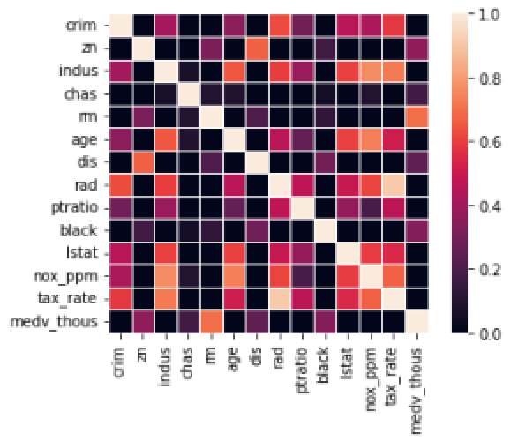
Data Science Approaches
Heatmap
Seaborn

Slide 5
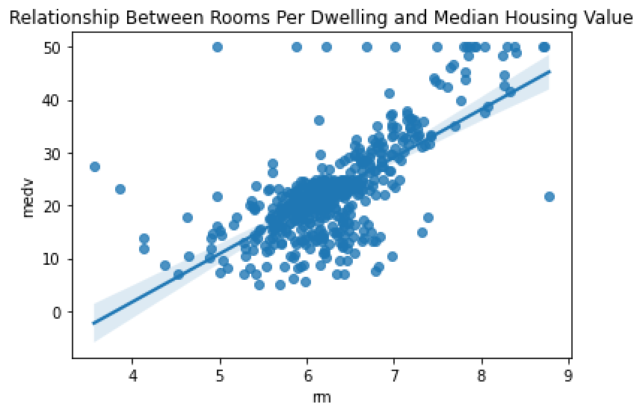
Data Science Approaches cont.
Linear regressions
Seaborn and SKlearn
Predictive Model
Average of predicted medians
KNN-classifier
Low, medium, and high value areas

Slide 6
Results and Conclusions
3 most relevant factors were “black,” “zn,” “rm”
KNN classifier achieved higher accuracy using only relevant factors
Data is not particularly useful for finding housing

Slide 7
Future Work
Find more recent data
Adapt the predictive model to use weight

Slide 8
Works Cited
Harrison, D., Jr. and D.L. Rubinfield. 1978. “Hedonic Housing Prices and the Demand for Clean Air.” Journal of Environmental Economics and Management 5: 81-102.
kaggle. (2021) Boston Housing Dataset (v1) [Dataset] Retrieved from https://www.kaggle.com/datasets/38ee67b8d08287d8ac8634870cb9651908b6e49c0ae11ce1564080167a1bd1c8?resource=download.
Northeastern University Housing and Residential Life. (2014) Upperclassmen Housing Rates 2021-2022. https://www.northeastern.edu/housing/wp-content/uploads/2021/08/Upperclass-Rates-FA21.pdf.

